Slide 1
Open source information to increase commitments and leverage to external platform connectivity:
Action Agenda website components in the external websites
Objective:
Install and deploy the following format widgets/open source components from the GIT HUB, Action Agenda Network, platform:
View widget
Search widget
Form widget
Websites for operation:
The CMS website from your organization
SCBD action agenda component documentation, GIT HUB:
https://scbd.github.io/action-agenda-components/widgets/
Websites demo for presentation:
CBD Drupal website page
SCBD action agenda component documentation, GIT HUB:
https://scbd.github.io/action-agenda-components/widgets/
Note
The codes in the Action Agenda component documentation, GIT HUB, the Action Agenda Network, are available also for any other website (CMS), not only for Drupal:)

Slide 2
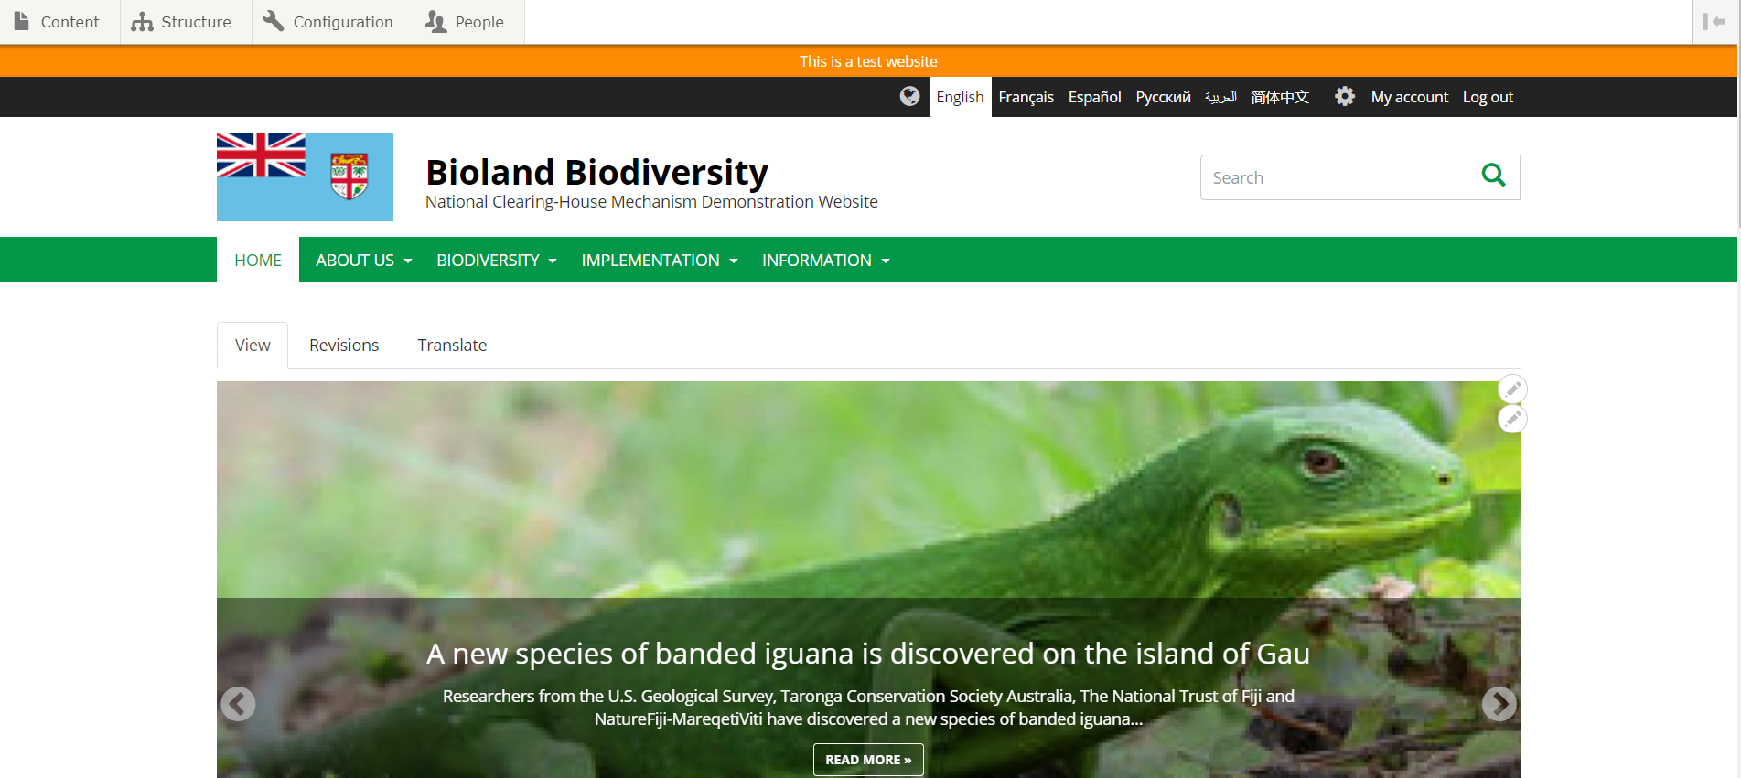
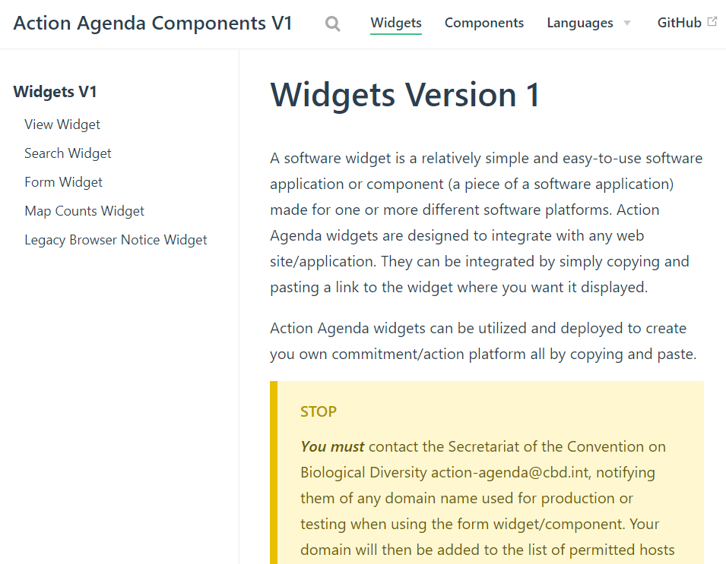
Code documentation
Drupal website

Slide 3
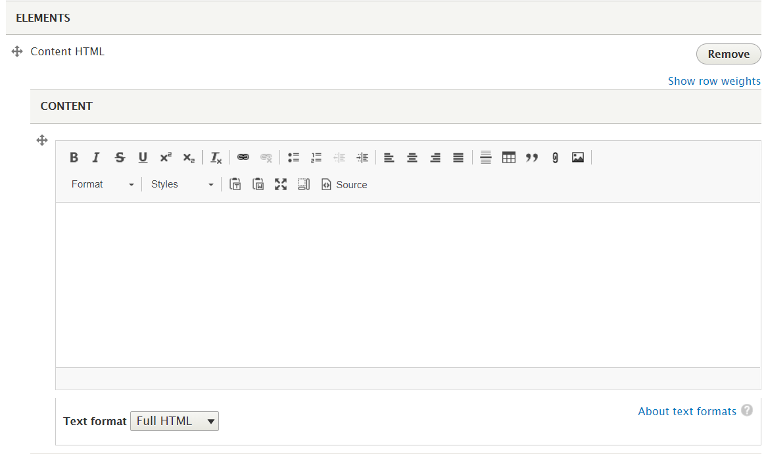
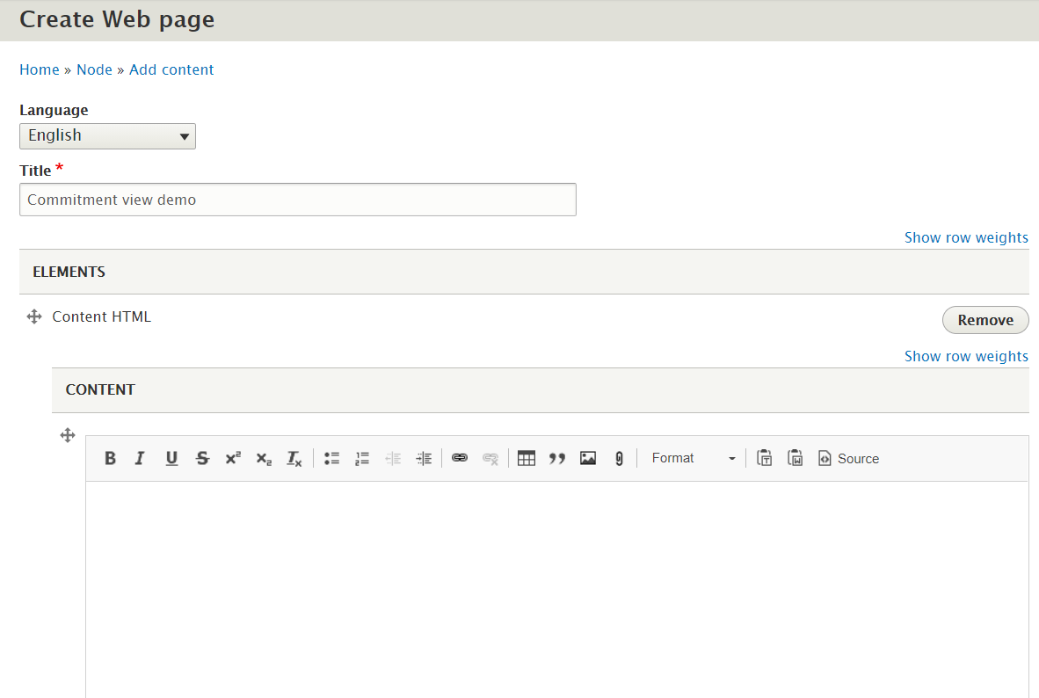
Steps
1. Go to the web page for publishing.
2. Choose “Full HTML” for text format(if available).

Slide 4
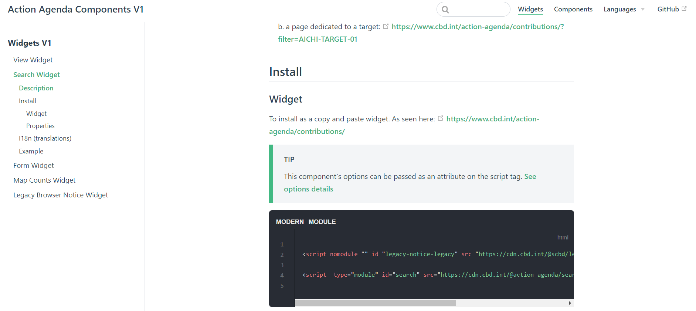
3. Go to the documentation page, GIT HUB, Action Agenda Network, select the corresponding widget, open source component, on the left menu.
4. Find the code fragment in the “Install” part and copy the lines of code.
√

Slide 5
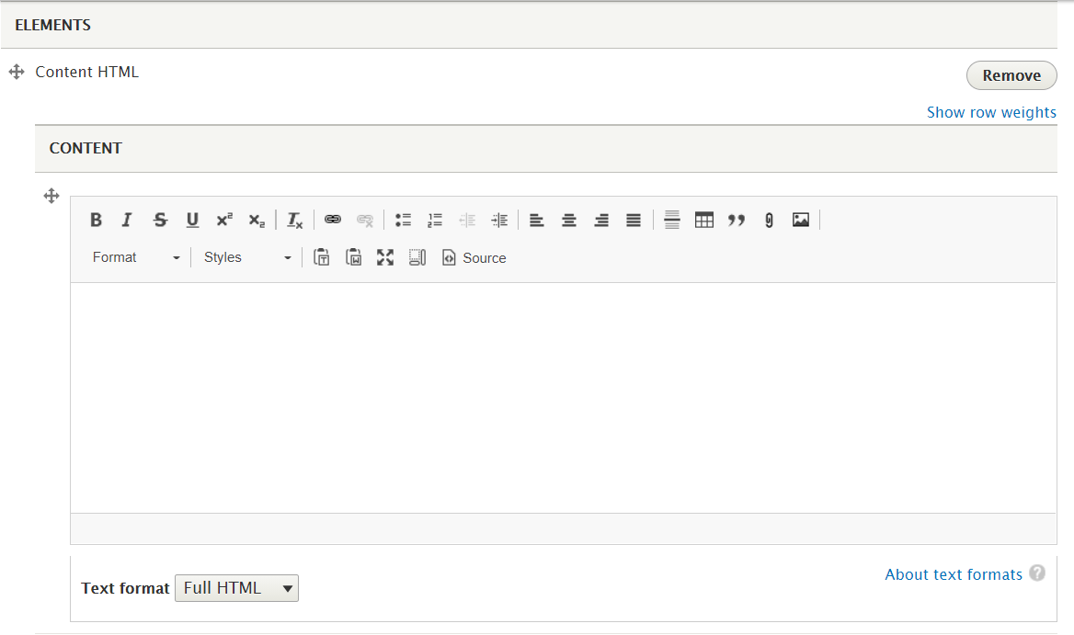
5. Go to the text field for editing, first click on the “Source button”.

Slide 6
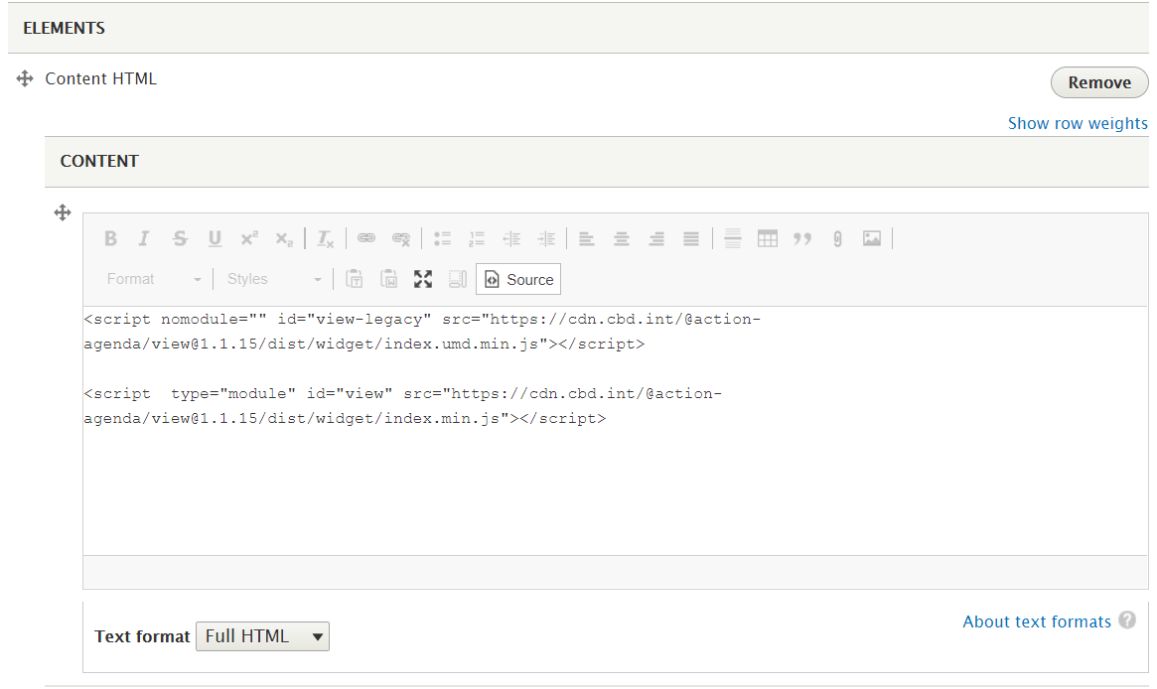
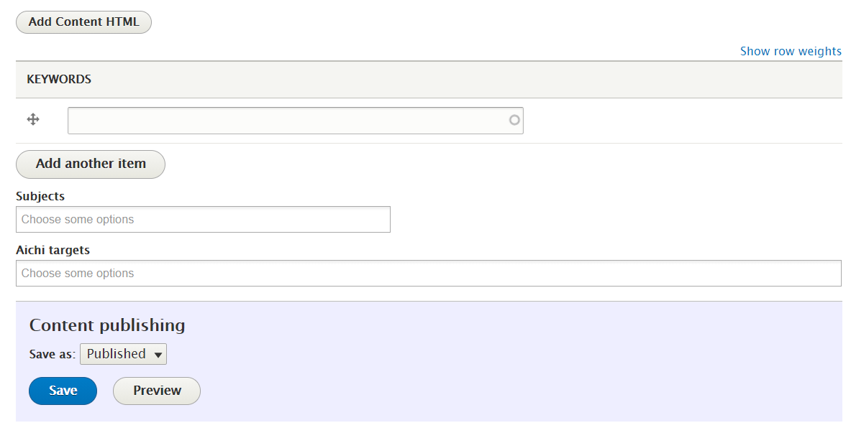
6. Then paste the codes.
7. Click on the “Save” button for publishing.

Slide 7
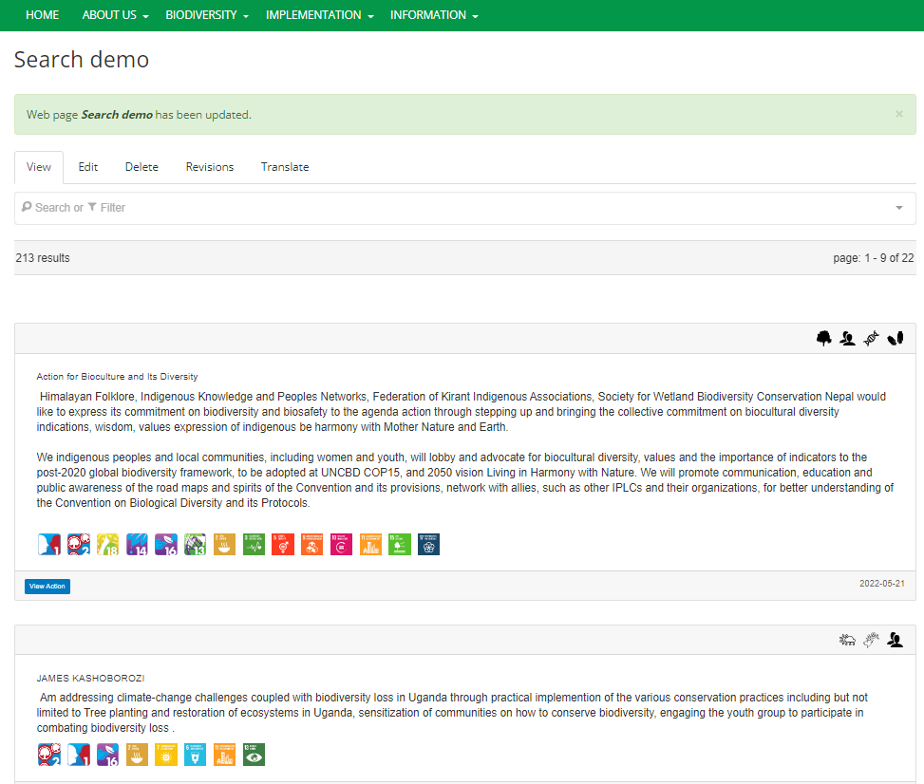
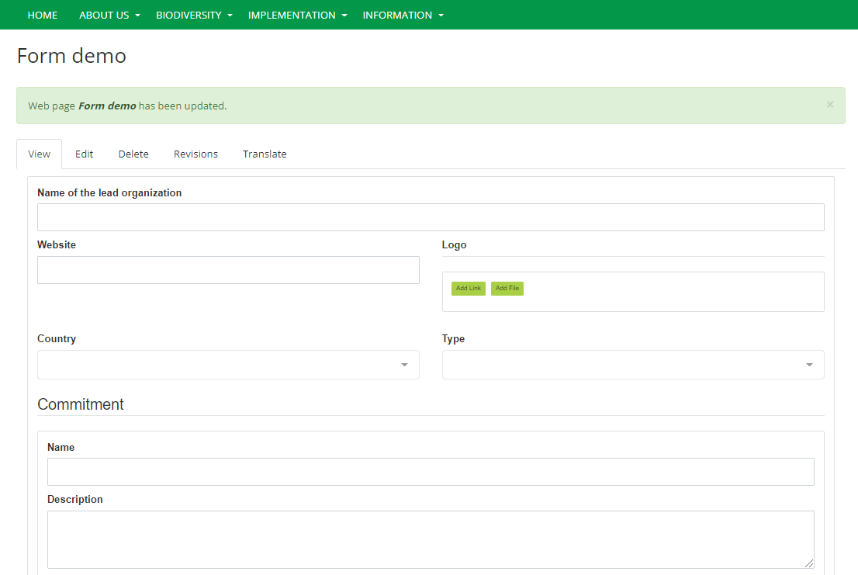
8. For search & form widgets, open source components, we can see the commitments on the page now.
All the steps are finished:)

Slide 8
9. For view widgets, there’s one more step:
Initially after publishing, we’ll see 404 Action not found error on the page,
because we need the specific action-id to see the corresponding commitment.
+
action-id of the commitment

Slide 9
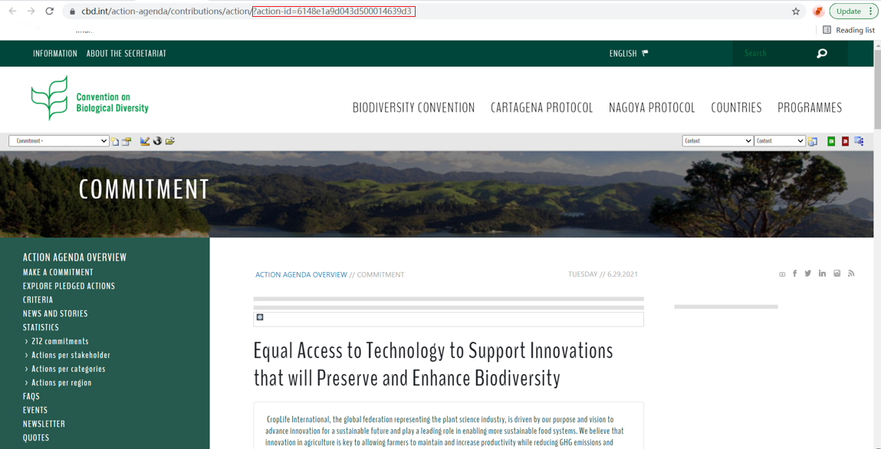
10. Find the action-id: in the one of the CBD commitments example below, we can find an action-id in the url, and what we need includes: ?action-id=xxxxxxx.
Copy them as a whole.

Slide 10
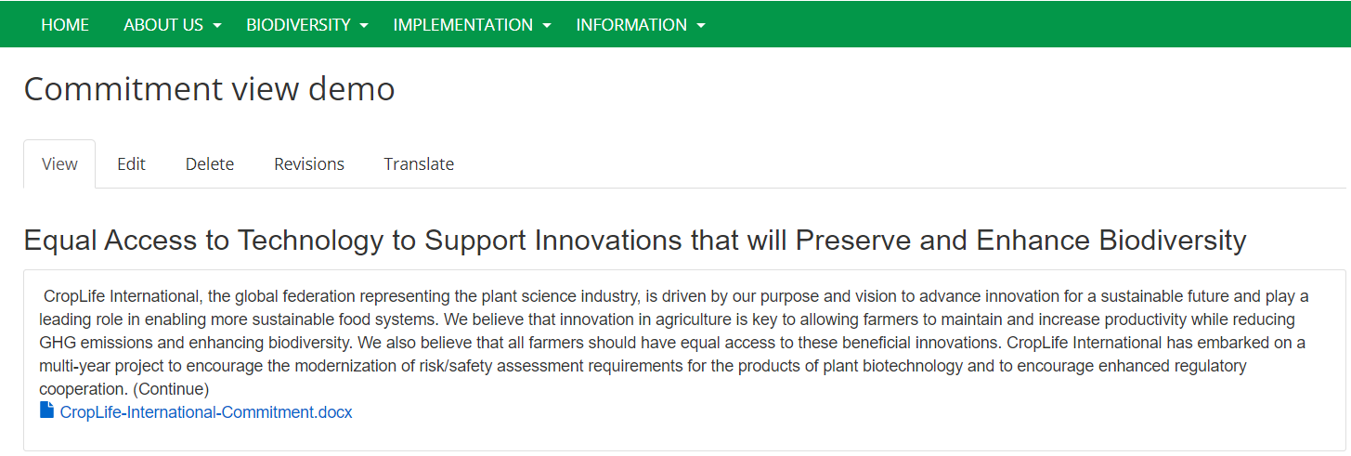
11. Go back to the Drupal website url, paste what we’ve copied in behind the current url, and press Enter.
Paste
And now we can see the commitment in detail!

